Slide 1
Red
Green

Slide 2
Red
Green

Slide 3
Red
Green

Slide 4



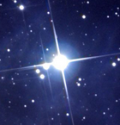

Star Varieties
Spikey 1 & 2
4 Tilt 1 & 2
Typical 5er 1 & 2
Round and Adorable 1 & 2

Slide 5











